Slide 1
Process files:
Blueprints for Agentic AI
Llewellyn Falco

Slide 2

“
Asking the LLM to do it just felt like... sitting at the drive-thru intercom
trying to make sure they got the "no meat" part,
and then pulling up to the second window and hoping the person slapping the sandwich together noticed that.
”
Sam Livingston-Gray

Slide 3
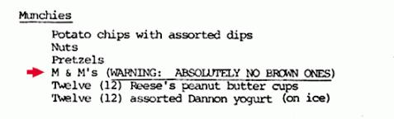


Canary clauses
and brown M&Ms

Slide 4
Canary clauses
rules.md
**ALWAYS** add the STARTER_CHARACTER followed by space at the start of your reply.
The STARTER_CHARACTER will change for each process file that is in progress.
Default STARTER_CHARACTER = 🧩
🧩 OK.

Slide 5

Context Window number of tokens the LLM can handle
Notes:
7000 + or - 2

Slide 6
Effective Context number of tokens before the responses start to significantly degrade
Notes:
7000 + or - 2

Slide 7
my.Process.md Files
late_night_coding.process.md
STARTER_CHARACTER = ☕
Ask for preferred caffeine, offer suggestions
Tell the user “just one more function”
Open IDE
Please read @late_night_coding.process.md and follow the instructions
☕ How would you like your caffeine? (coffee, tea, soda, intravenous)

Slide 8

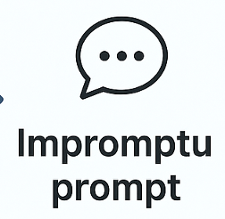

Components
of an Effective AI Prompt
Structured
Built
Impromptu
+
+
Data /
Context

Slide 9

Components
of an Effective AI Prompt
Structured
Built
Impromptu
Data /
Context
Human
in-the-loop
+
Data /
Context
Data /
Context
+
Data /
Context

Slide 10
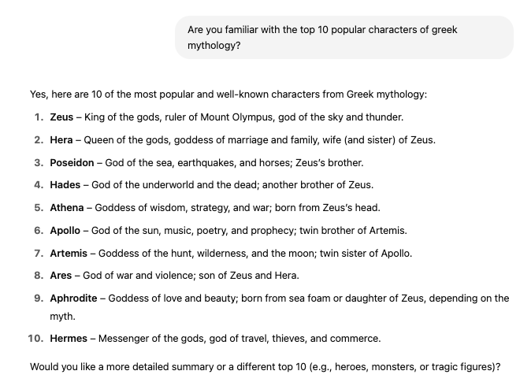
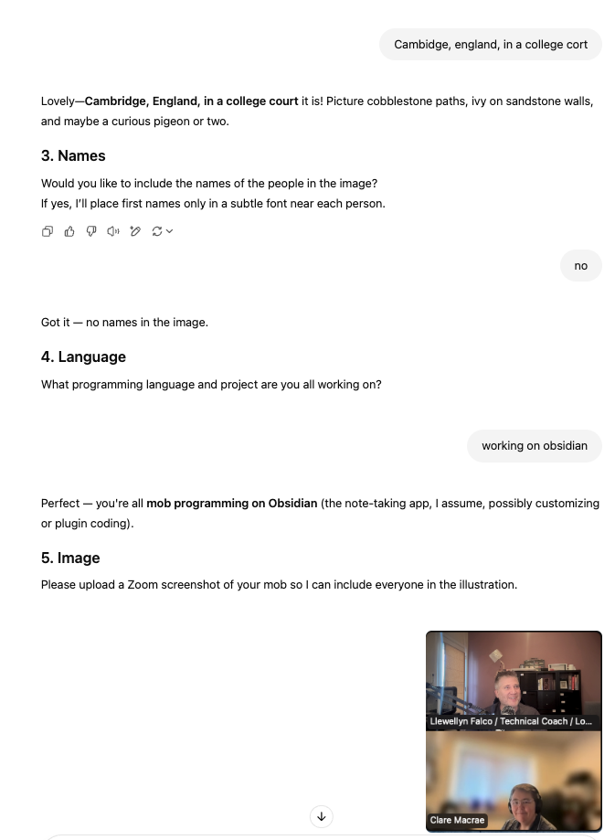
Human
in-the-loop
Pre-Heat
Interview me
Build a Doc
Diagram
Unit Test
Check List
✅ item 1
☐ item 2
☐ item 3

Slide 11



Actions
Structured
Built
Impromptu
A
Text
File Reads
+
+
Data /
Context
File Edits
Terminal
Commands

Slide 12
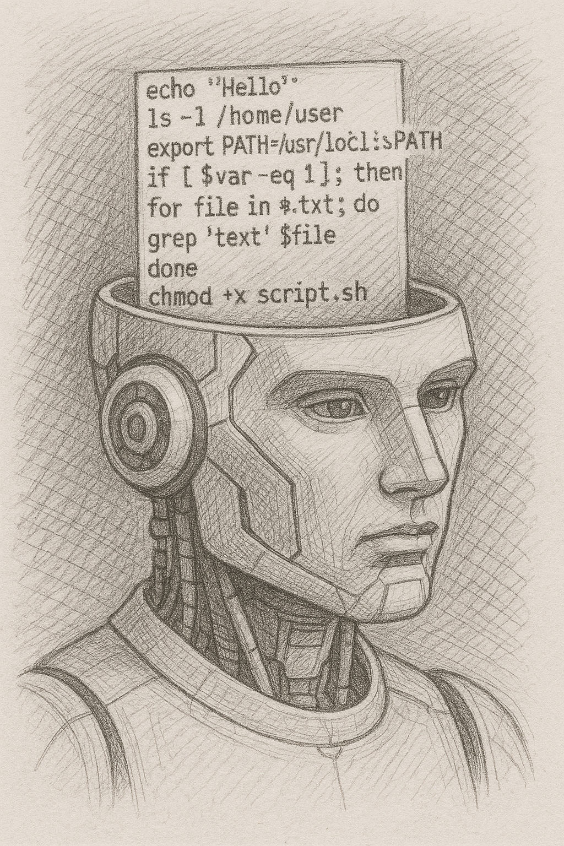
Actions
Terminal
Commands
AI fuzzy logic
Deterministic processes

Slide 13
Actions
Terminal
Commands
Deterministic processes
AI fuzzy logic

Slide 14
Actions
Run Tests
Terminal
Commands
-am,--also-make
-amd,--also-make-dependents
-B,--batch-mode
-b,--builder <arg>
-C,--strict-checksums
-c,--lax-checksums
--color <arg>
-cpu,--check-plugin-updates
-D,--define <arg>
-e,--errors
-emp,--encrypt-master-password <arg>
-ep,--encrypt-password <arg>
-f,--file <arg>
-fae,--fail-at-end
-ff,--fail-fast
-fn,--fail-never
-gs,--global-settings <arg>
-gt,--global-toolchains <arg>
-h,--help
-l,--log-file <arg>
-llr,--legacy-local-repository
-N,--non-recursive
-npr,--no-plugin-registry
-npu,--no-plugin-updates
-nsu,--no-snapshot-updates
-ntp,--no-transfer-progress
-o,--offline
-P,--activate-profiles <arg>
-pl,--projects <arg>
-q,--quiet
-rf,--resume-from <arg>
-s,--settings <arg>
-t,--toolchains <arg>
-T,--threads <arg>
-U,--update-snapshots
-up,--update-plugins
-v,--version
-V,--show-version
-X,--debug
clean
install test verify
mvn
Java
graddle

Slide 15
Actions
Run Tests
Terminal
Commands
rules.md
To run tests: `./build_and_test.sh`

Slide 16
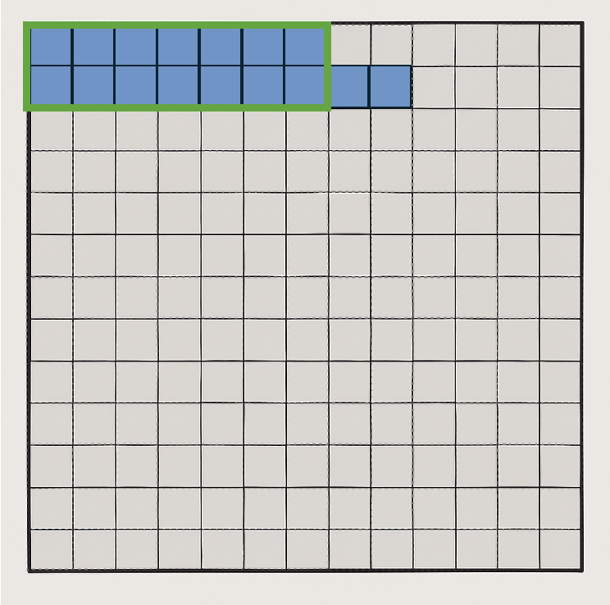
Actions
Feedback
Terminal
Commands
rule[INFO] Scanning for projects...
[INFO]
[INFO] --------------< starterproject:approvaltests_playground >---------------
[INFO] Building approvaltests_playground 1.0-SNAPSHOT
[INFO] --------------------------------[ jar ]---------------------------------
[INFO]
[INFO] --- maven-resources-plugin:2.6:resources (default-resources) @ approvaltests_playground ---
[WARNING] Using platform encoding (UTF-8 actually) to copy filtered resources, i.e. build is platform dependent!
[INFO] skip non existing resourceDirectory /Users/llewellynfalco/Github/AgenticAi.Java.StarterProject/src/main/resources
[INFO]
[INFO] --- maven-compiler-plugin:3.14.0:compile (default-compile) @ approvaltests_playground ---
[INFO] Nothing to compile - all classes are up to date.
[INFO]
[INFO] --- maven-resources-plugin:2.6:testResources (default-testResources) @ approvaltests_playground ---
[WARNING] Using platform encoding (UTF-8 actually) to copy filtered resources, i.e. build is platform dependent!
[INFO] skip non existing resourceDirectory /Users/llewellynfalco/Github/AgenticAi.Java.StarterProject/src/test/resources
[INFO]
[INFO] --- maven-compiler-plugin:3.14.0:testCompile (default-testCompile) @ approvaltests_playground ---
[INFO] Nothing to compile - all classes are up to date.
[INFO]
[INFO] --- maven-surefire-plugin:3.5.3:test (default-test) @ approvaltests_playground ---
[INFO] Using auto detected provider org.apache.maven.surefire.junitplatform.JUnitPlatformProvider
[INFO]
[INFO] -------------------------------------------------------
[INFO] T E S T S
[INFO] -------------------------------------------------------
[INFO] Running org.samples.SampleTests
[INFO] Tests run: 3, Failures: 0, Errors: 0, Skipped: 0, Time elapsed: 0.327 s -- in org.samples.SampleTests
[INFO] Running org.samples.HexBoardTest
[INFO] Tests run: 5, Failures: 0, Errors: 0, Skipped: 0, Time elapsed: 0.142 s -- in org.samples.HexBoardTest
[INFO]
[INFO] Results:
[INFO]
[INFO] Tests run: 8, Failures: 0, Errors: 0, Skipped: 0
[INFO]
[INFO]
[INFO] --- maven-jar-plugin:2.4:jar (default-jar) @ approvaltests_playground ---
[INFO] ------------------------------------------------------------------------
[INFO] BUILD SUCCESS
[INFO] ------------------------------------------------------------------------
[INFO] Total time: 3.489 s
[INFO] Finished at: 2025-05-20T05:09:25-06:00
[INFO] ------------------------------------------------------------------------s.md

Slide 17
Actions
mvn verify –-output=ai
Terminal
Commands
./build_and_test.sh
[INFO] Scanning for projects...
[INFO]
[INFO] --------------< starterproject:approvaltests_playground >---------------
[INFO] Building approvaltests_playground 1.0-SNAPSHOT
[INFO] --------------------------------[ jar ]---------------------------------
[INFO]
[INFO] --- maven-resources-plugin:2.6:resources (default-resources) @ approvaltests_playground ---
[WARNING] Using platform encoding (UTF-8 actually) to copy filtered resources, i.e. build is platform dependent!
[INFO] skip non existing resourceDirectory /Users/llewellynfalco/Github/AgenticAi.Java.StarterProject/src/main/resources
[INFO]
[INFO] --- maven-compiler-plugin:3.14.0:compile (default-compile) @ approvaltests_playground ---
[INFO] Nothing to compile - all classes are up to date.
[INFO]
[INFO] --- maven-resources-plugin:2.6:testResources (default-testResources) @ approvaltests_playground ---
[WARNING] Using platform encoding (UTF-8 actually) to copy filtered resources, i.e. build is platform dependent!
[INFO] skip non existing resourceDirectory /Users/llewellynfalco/Github/AgenticAi.Java.StarterProject/src/test/resources
[INFO]
[INFO] --- maven-compiler-plugin:3.14.0:testCompile (default-testCompile) @ approvaltests_playground ---
[INFO] Nothing to compile - all classes are up to date.
[INFO]
[INFO] --- maven-surefire-plugin:3.5.3:test (default-test) @ approvaltests_playground ---
[INFO] Using auto detected provider org.apache.maven.surefire.junitplatform.JUnitPlatformProvider
[INFO]
[INFO] -------------------------------------------------------
[INFO] T E S T S
[INFO] -------------------------------------------------------
[INFO] Running org.samples.SampleTests
[INFO] Tests run: 3, Failures: 0, Errors: 0, Skipped: 0, Time elapsed: 0.323 s -- in org.samples.SampleTests
[INFO] Running org.samples.HexBoardTest
[May 20, 2025, 5:23:45 AM ~000000ms] To approve run : mv -f /Users/llewellynfalco/Github/AgenticAi.Java.StarterProject/src/test/java/org/samples/HexBoardTest.create11x4HexBoard_andRenderAsciiArt.received.txt /Users/llewellynfalco/Github/AgenticAi.Java.StarterProject/src/test/java/org/samples/HexBoardTest.create11x4HexBoard_andRenderAsciiArt.approved.txt
[ERROR] Tests run: 5, Failures: 1, Errors: 0, Skipped: 0, Time elapsed: 0.228 s <<< FAILURE! -- in org.samples.HexBoardTest
[ERROR] org.samples.HexBoardTest.create11x4HexBoard_andRenderAsciiArt -- Time elapsed: 0.110 s <<< FAILURE!
org.opentest4j.AssertionFailedError:
expected: <Hexboard 11x4
( 0,0) ( 0,2) ( 0,4) ( 0,6)
( 1,1) ( 1,3) ( 1,5) ( 1,7)
( 2,0) ( 2,2) ( 2,4) ( 2,6)
( 3,1) ( 3,3) ( 3,5) ( 3,7)
( 4,0) ( 4,2) ( 4,4) ( 4,6)
( 5,1) ( 5,3) ( 5,5) ( 5,7)
( 6,0) ( 6,2) ( 6,4) ( 6,6)
( 7,1) ( 7,3) ( 7,5) ( 7,7)
( 8,0) ( 8,2) ( 8,4) ( 8,6)
( 9,1) ( 9,3) ( 9,5) ( 9,7)
(10,0) (10,2) (10,4) (10,6)
> but was: <Hexboard 10x4
(0,0) (0,2) (0,4) (0,6)
(1,1) (1,3) (1,5) (1,7)
(2,0) (2,2) (2,4) (2,6)
(3,1) (3,3) (3,5) (3,7)
(4,0) (4,2) (4,4) (4,6)
(5,1) (5,3) (5,5) (5,7)
(6,0) (6,2) (6,4) (6,6)
(7,1) (7,3) (7,5) (7,7)
(8,0) (8,2) (8,4) (8,6)
(9,1) (9,3) (9,5) (9,7)
>
at org.junit.jupiter.api.AssertionFailureBuilder.build(AssertionFailureBuilder.java:151)
at org.junit.jupiter.api.AssertionFailureBuilder.buildAndThrow(AssertionFailureBuilder.java:132)
at org.junit.jupiter.api.AssertEquals.failNotEqual(AssertEquals.java:197)
at org.junit.jupiter.api.AssertEquals.assertEquals(AssertEquals.java:182)
at org.junit.jupiter.api.AssertEquals.assertEquals(AssertEquals.java:177)
at org.junit.jupiter.api.Assertions.assertEquals(Assertions.java:1145)
at java.base/jdk.internal.reflect.DirectMethodHandleAccessor.invoke(DirectMethodHandleAccessor.java:104)
at java.base/java.lang.reflect.Method.invoke(Method.java:577)
at org.approvaltests.reporters.AbstractJUnitReporter.assertEquals(AbstractJUnitReporter.java:25)
at org.approvaltests.reporters.AbstractJUnitReporter.report(AbstractJUnitReporter.java:45)
at org.approvaltests.reporters.FirstWorkingReporter.report(FirstWorkingReporter.java:23)
at org.approvaltests.approvers.FileApprover.reportFailure(FileApprover.java:68)
at org.approvaltests.Approvals.verify(Approvals.java:234)
at org.approvaltests.Approvals.verify(Approvals.java:188)
at org.approvaltests.Approvals.verify(Approvals.java:196)
at org.approvaltests.Approvals.verify(Approvals.java:55)
at org.approvaltests.Approvals.verify(Approvals.java:64)
at org.approvaltests.Approvals.verify(Approvals.java:59)
at org.samples.HexBoardTest.create11x4HexBoard_andRenderAsciiArt(HexBoardTest.java:28)
at java.base/java.lang.reflect.Method.invoke(Method.java:577)
at java.base/java.util.ArrayList.forEach(ArrayList.java:1511)
at java.base/java.util.ArrayList.forEach(ArrayList.java:1511)
[INFO]
[INFO] Results:
[INFO]
[ERROR] Failures:
[ERROR] HexBoardTest.create11x4HexBoard_andRenderAsciiArt:28 expected: <Hexboard 11x4
( 0,0) ( 0,2) ( 0,4) ( 0,6)
( 1,1) ( 1,3) ( 1,5) ( 1,7)
( 2,0) ( 2,2) ( 2,4) ( 2,6)
( 3,1) ( 3,3) ( 3,5) ( 3,7)
( 4,0) ( 4,2) ( 4,4) ( 4,6)
( 5,1) ( 5,3) ( 5,5) ( 5,7)
( 6,0) ( 6,2) ( 6,4) ( 6,6)
( 7,1) ( 7,3) ( 7,5) ( 7,7)
( 8,0) ( 8,2) ( 8,4) ( 8,6)
( 9,1) ( 9,3) ( 9,5) ( 9,7)
(10,0) (10,2) (10,4) (10,6)
> but was: <Hexboard 10x4
(0,0) (0,2) (0,4) (0,6)
(1,1) (1,3) (1,5) (1,7)
(2,0) (2,2) (2,4) (2,6)
(3,1) (3,3) (3,5) (3,7)
(4,0) (4,2) (4,4) (4,6)
(5,1) (5,3) (5,5) (5,7)
(6,0) (6,2) (6,4) (6,6)
(7,1) (7,3) (7,5) (7,7)
(8,0) (8,2) (8,4) (8,6)
(9,1) (9,3) (9,5) (9,7)
>
[INFO]
[ERROR] Tests run: 8, Failures: 1, Errors: 0, Skipped: 0
[INFO]
[INFO] ------------------------------------------------------------------------
[INFO] BUILD FAILURE
[INFO] ------------------------------------------------------------------------
[INFO] Total time: 3.411 s
[INFO] Finished at: 2025-05-20T05:23:45-06:00
[INFO] ------------------------------------------------------------------------
[ERROR] Failed to execute goal org.apache.maven.plugins:maven-surefire-plugin:3.5.3:test (default-test) on project approvaltests_playground: There are test failures.
[ERROR]
[ERROR] See /Users/llewellynfalco/Github/AgenticAi.Java.StarterProject/target/surefire-reports for the individual test results.
[ERROR] See dump files (if any exist) [date].dump, [date]-jvmRun[N].dump and [date].dumpstream.
[ERROR] -> [Help 1]
[ERROR]
[ERROR] To see the full stack trace of the errors, re-run Maven with the -e switch.
[ERROR] Re-run Maven using the -X switch to enable full debug logging.
[ERROR]
[ERROR] For more information about the errors and possible solutions, please read the following articles:
[ERROR] [Help 1] http://cwiki.apache.org/confluence/display/MAVEN/MojoFailureException
❌ Build failed.
./build_and_test.sh
✅ Built: 8 tests passed.

Slide 18
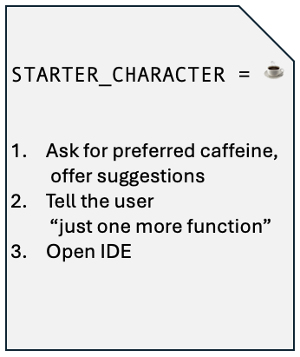
my.Process.md Files
late_night_coding.process.md
Windsurf → Workflows
Copilot → Instructions
Cursor → Rules

Slide 19
my.Process.md Files
late_night_coding.process.md
Windsurf → Workflows
Copilot → Instructions
Cursor → Rules

Slide 20
Trained for Agentic
Claude 3.5+
Chat GPT 4.1
Google Gemini 2.5 Pro

Slide 21
?
Let’s code?…

Slide 22
Components
of an Effective AI Prompt
Structured
Built
Impromptu
Data /
Context
Human
in-the-loop
+
Data /
Context
Data /
Context
+
Data /
Context

Slide 23
my.Process.md Files
>.windsurf/processes/
💻 BashScripts.process.md 🔴 TDD.creating_tests.process.md
🟢 TDD.implement_production.process.md
🟣 TDD.refactoring.process.md

Slide 24
?
Let’s code?…

Slide 25
Notes:
7000 + or - 2

